Slide 1
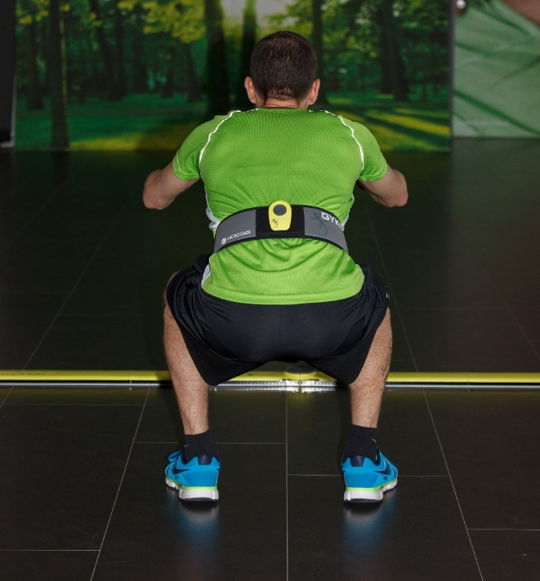
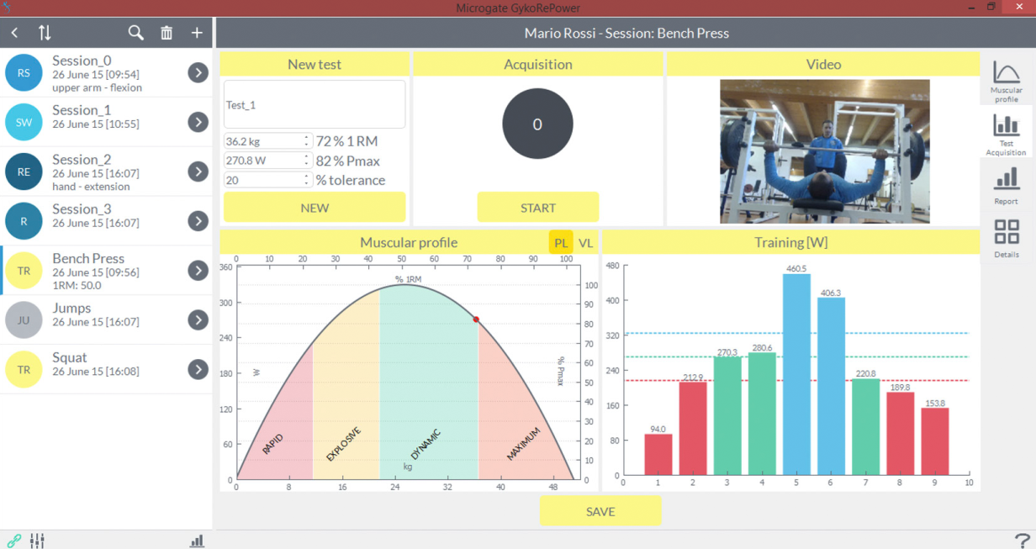
Power - Leg
i.e. Bosco Protocol
Squat Jump
Counter Movement Jump
Drop Jump 40 cm
15 secondi di salti continui
Muscolar profilation and ad-hoc training

Slide 2
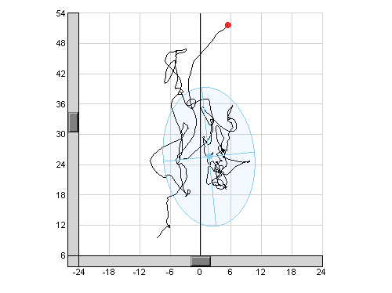
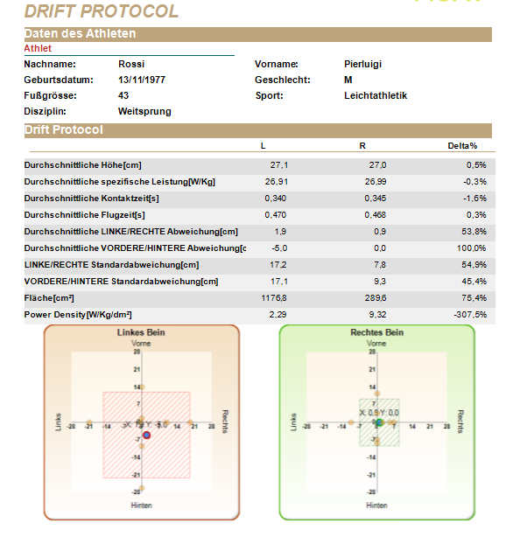
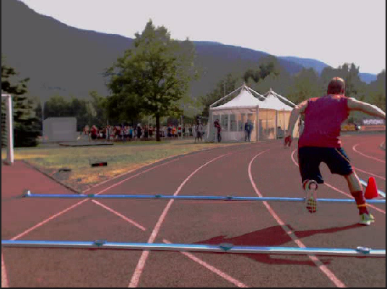
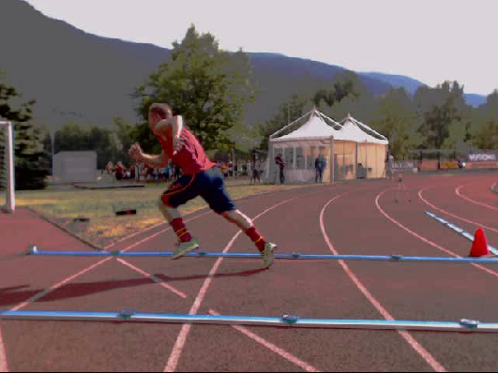
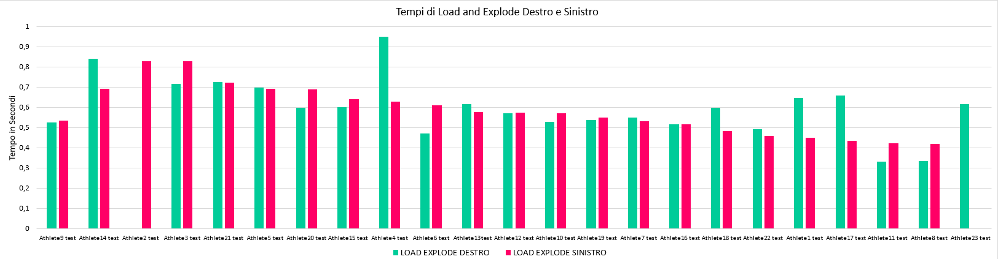
Power – the different aspects
You can easly deepen in the different aspects

Slide 3

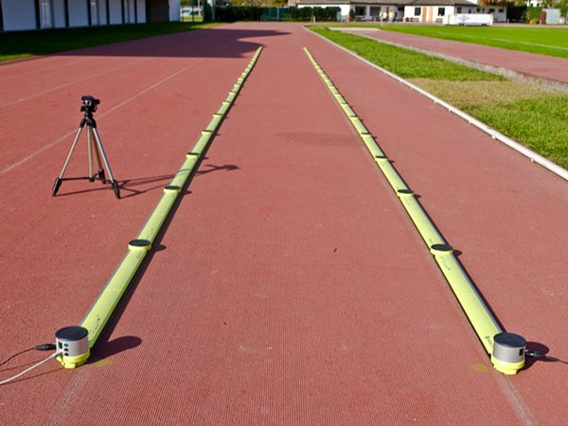
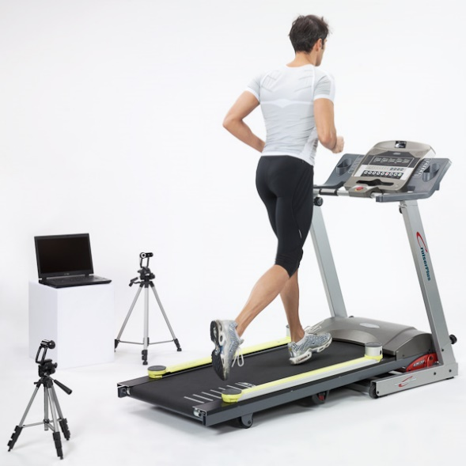
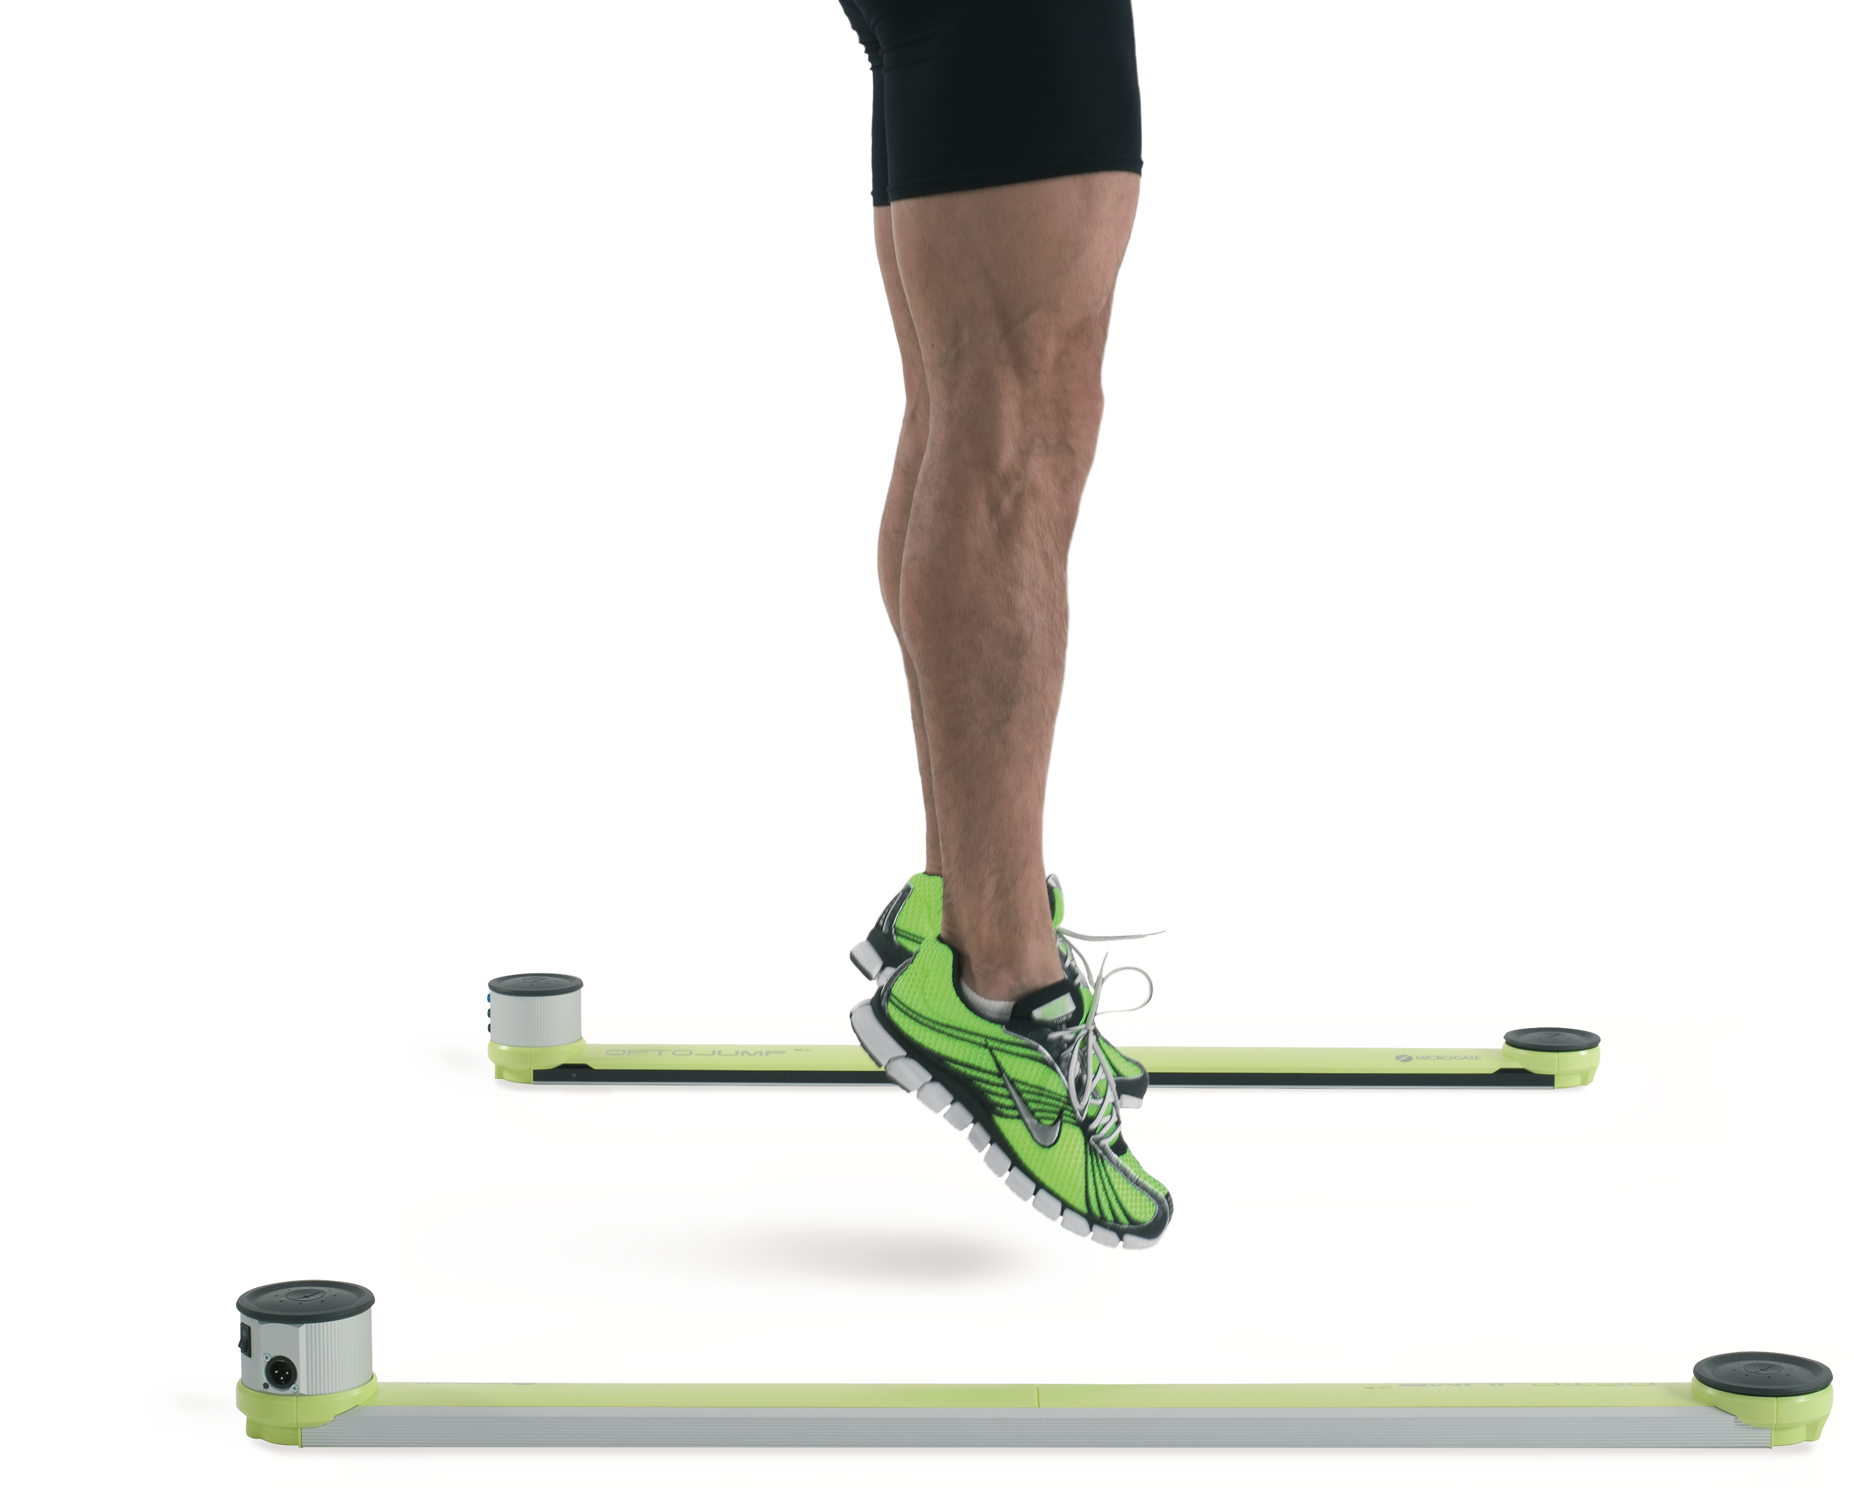
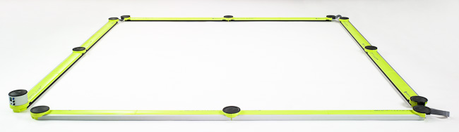
Accurate infrared technology
Quantitative and qualitative analysis (webcams)
Easy to setup
Flexible

Slide 4

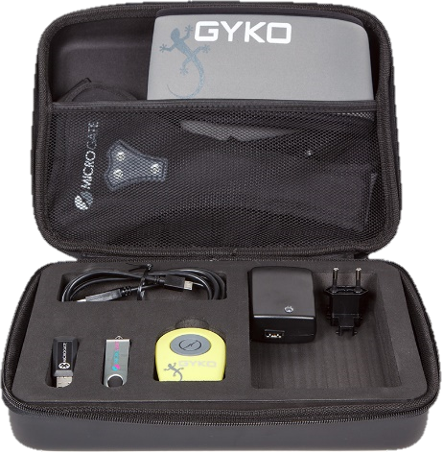
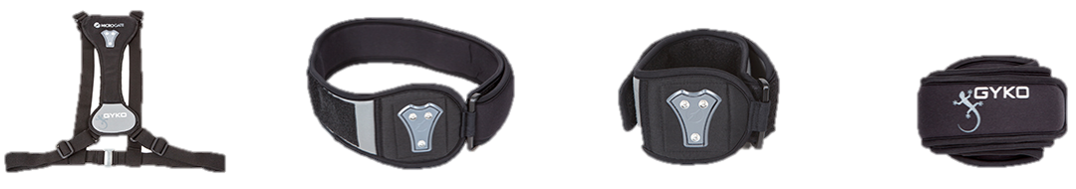
3 axis accelerometer, gyroscope, magnetometer
1 KHz sampling rate
Bluetooth 4.0
Used with OptoJump/OptoGait or RePower Software
Pelvic belt, the vest, two belts of different sizes for upper and lower limbs and a magnetic support

Slide 5
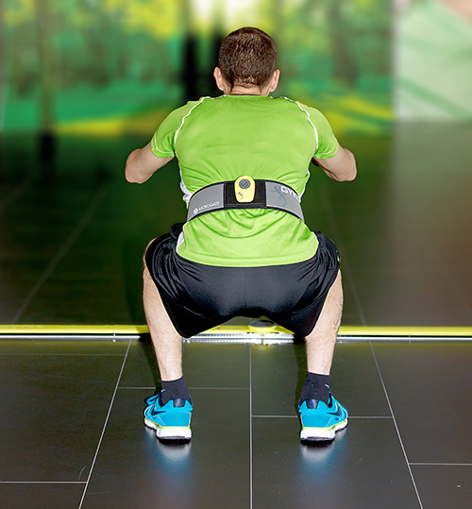
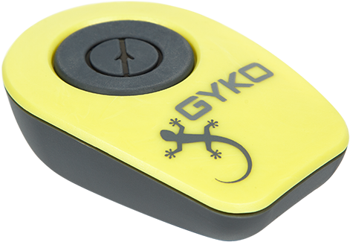
In combination with OptoJump Next or standalone:
  Eccentric and concentric work and duration
  Force, Velocity and Maximum Power
  Rate of Force Development
  and Landing Rate

Slide 6

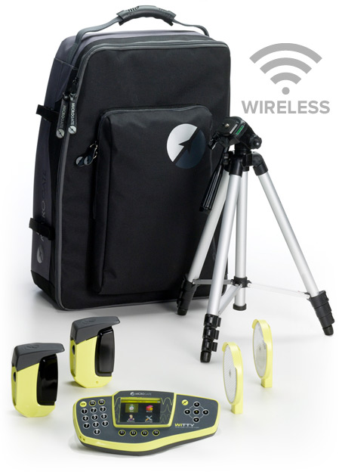
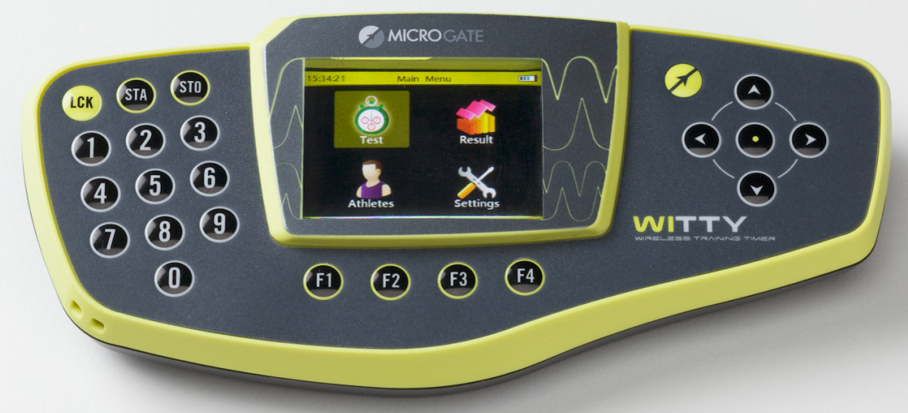
Easy to perform all the athletic tests typical of modern athletic preparation (such as sprint, shuttle, resistance, courses) and to acquire their results with an accuracy higher than 1/1000s
New wireless Timing Kit for Training
First chronometer with COLOR display and easy User Interface
Highly Portable

Slide 7

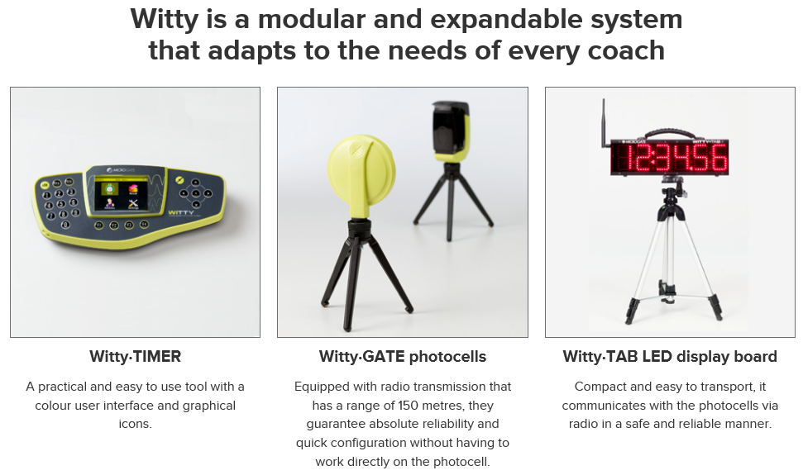
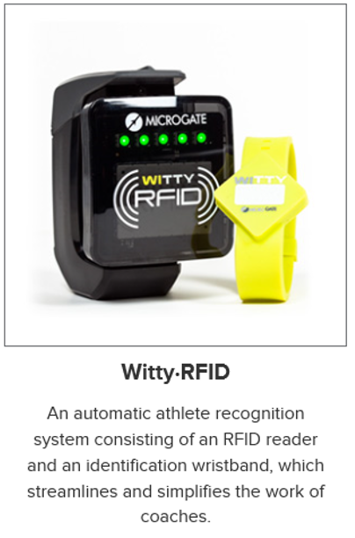

Slide 8
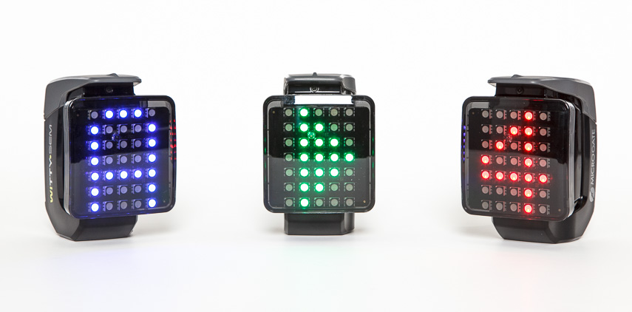
News! Cognition in motion
Intelligent Traffic light
Led multicolor matrix 7x5
Symbols and colors
Proximity sensor
Jack for external impulses

Slide 9

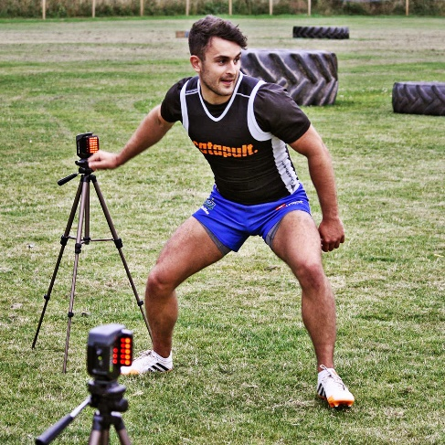
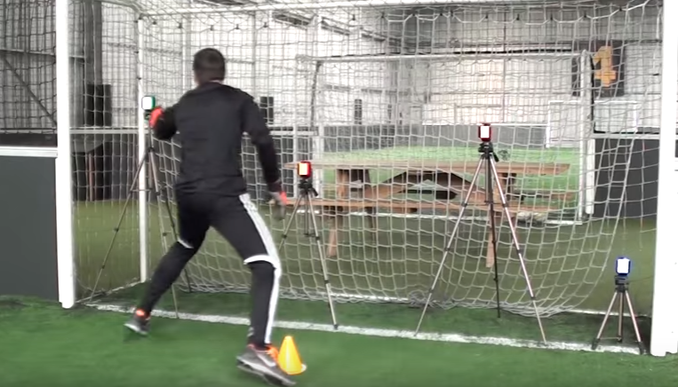
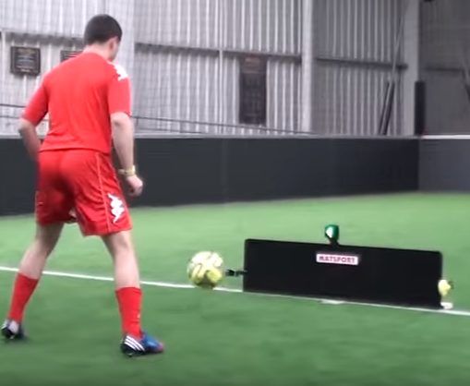
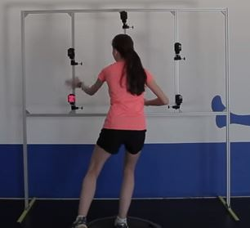
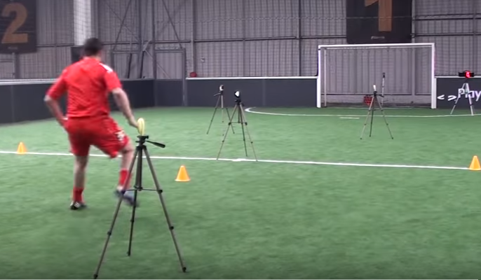
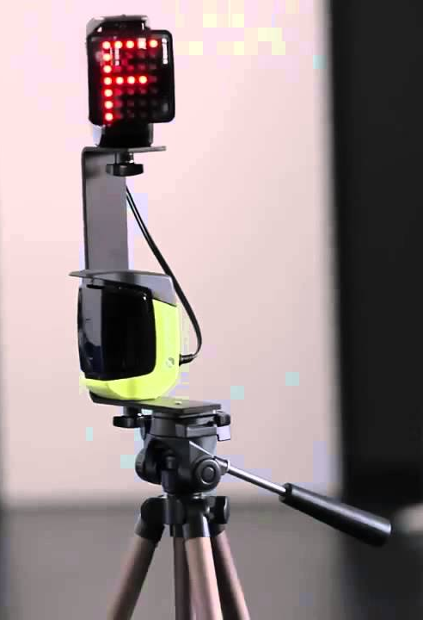
News! Cognition in motion

Slide 10
Cognition in motion = Brain training
We started a cooperation with Brain HQ - Real science to believe in (Dr. Michael Merzenich) with 100+ Published Research Studies
Training bring to cognitive benefits (such as better memory and faster processing) as well as real-life benefits (such as safer driving and better hearing in noisy places) – movement in a game is 70% processing and 30% acting
attention, memory, brain speed, people skills, navigation, and intelligence. Different levels of exercises.

